Slide 1
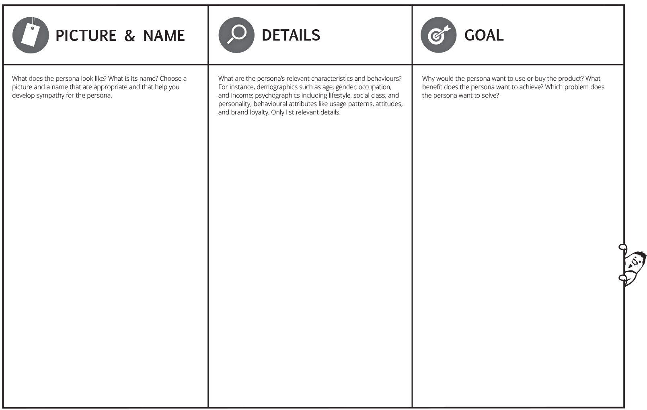
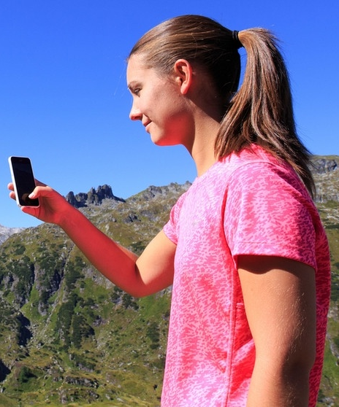
Personas
Focus on hobby hiker
Annemarie
-26 years
-Female
-Works in a advertising agency
-In relationship with Tom (31)
-Sporty person
-Likes yoga
-Likes weekend trips combined with hiking
-Advanced tech savviness
-Wants minimize the planning and navigation efforts before and during the hiking trip
-Wants to have actual information
-Does not want to spent money for unnecessary information (like comprehensive hiking guide)
(-Wants to push her Instagram channel with personal impressions and experiences)

Slide 2
Empathy map canvas
Hobby hiker view
-Hobby hiker
-Information about a hiking trail
-Guiding and exploration service for hiking
-Physical maps
-Hiking is dangerous
-Restaurants are overcrowded
“I just want to go for an easy trip into the mountains without much effort for planning”
-Buy hiking guides
-Use expensive apps
-Prepare their trips with lot of effort via internet

Slide 3
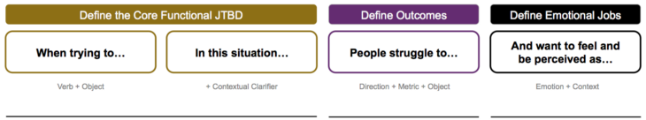
Jobs to be done
Jobs for the customer
…hike in the mountains
…vacation or free time
…prepare their hiking trips
…find the best route depending on their preferences e.g. fitness or time
…get specific map material
…spend money for one time map material
…find the best fitting hiking track
…relaxed during the preparation process and excited and secure while hiking

Slide 4
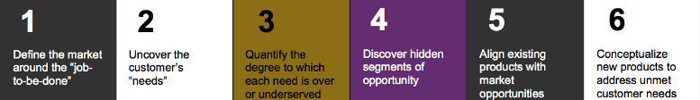
Customer innovation process
When is was tired of searching, I learned to find.” - Goethe
Outdoor activities
Hiking
Outdoor navigation
1. Easy planning
2. On-site information
3. Navigation
4. Real-time information
Rang from 1 – 6
3 -4
3
2
4-5
Seamless navigation
On-site information
More information
Customized information about trails according to the customer need
Hiking – navigation apps
-> just app based information
Maps
-> Comprehensive planning effort required
Signs
-> static and limited
“Wanderlust” offers:
On-site installed information “spots” via Beacons which are able to interact with the hiker in a seamless, natural and comfortable way. Optional functionality to provide real-time information in accordance to the current location and hiker’s individual needs

Slide 5
Product vision board
Providing information and services in an natural environment enabled by the merger of the physical web and the web of things.
Easy and seamless information provision and usage.
Hobby hiker
Outdoor explorer
Micro adventurer
Easy planning
On-site information
Navigation
Real-time information
“Wanderlust” offers:
On-site installed information “spots” via Beacons which are able to interact with the hiker in a seamless, natural and comfortable way.
Platform for individual service offerings form ourselves and partners
Location-based, seamless, embedded in the real world and providing real-time information
Easy to use
Supports an agile “leisure time design”
YES – Standard components aligned in a smart real-world embedded way
Sell an unprecedented service to large and growing customer segment which is able to satisfy an unmet customer need
Platform role in the market
Generate early revenues
Sell up advertising space
Cross sales opportunities
Revenue via partner fees
On-site option for sales
Get wide reach
Early market entrance

Slide 6
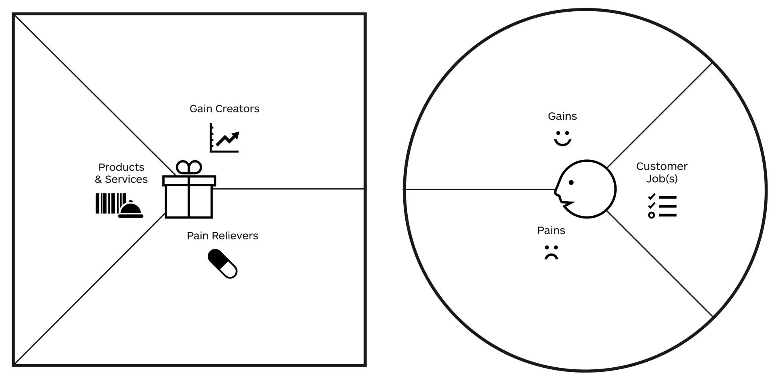
Value proposition canvas
Hiking as a Service
Reduced effort for information gathering
Seamless usage
Proactive interaction
No installation required
Free choice of devices
1. Easy planning
2. Actual on-site information
3. Navigation
4. Real-time information
1. Planning
2. Gathering actual on-site information
3. Navigation
Information service
Platform for partners
Low planning efforts via provision on-site information
Route recommendation
Specific information
Low cost
Actual information
1. Exhausting preparation of hiking trips required
2. Finding the best route depending on personal preferences e.g. fitness or time is just possible in an limited way
3. Specific map material in accordance to the real needs is not available (just comprehensive stuff like big maps or hiking guides
4. Relatively high cost
5. Information often outdated

